Slide 1
Egress Window Existing Residential Occupancies
(These slides include animated explanations. You must play the slide show from the beginning to see the animations.)

Slide 2


Double Hung
Example: 648 sq.in. required opening size divided by 20 inch minimum width equals 32.4 inches in height to be code compliant
Height
At least 20”
Minimum
648 in²
Width
At least 20”
Height x Width = Area

Slide 3
Sliding
Example: 648 sq.in. required opening size divided by 40 inch height equals 16.2 inches in width, but shall be 20 inches to be code compliant
Height
At least 20”
Minimum
648 in²
Width
At least 20”
Height x Width = Area

Slide 4
Casement
Example: 648 sq.in. required opening size divided by 24 inch width equals 27 inches in height and is code compliant
Height
At least 20”
Minimum
648 in²
Width
At least 20”
Height x Width = Area

Slide 5





Casement
Cutaway View
BOTH the rough window opening AND the clearance left by the open window MUST be no less than 20” in width.
Width
No less than 20”

Slide 6


Height from bottom of opening to floor
Maximum of 48”
≤ 48”
≤ 48”
> 48”

Slide 7
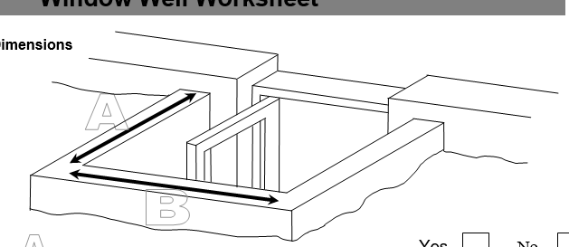
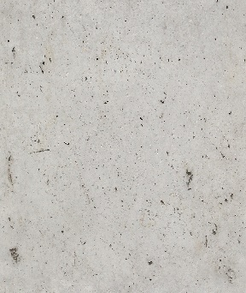




Window Well
Minimum 1296 in²

Slide 8
Window Well
Example: 1296 sq.in. required window well divided by 48 inch width equals 27 inch depth, but minimum depth is 36 inches to be code compliant
Minimum 1296 in²
A
at least 36”
B
at least 36”
D
at least 36”
W
at least 36”
Depth x Width = Area

Slide 9
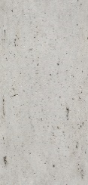
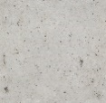
Window Well
Vertical Depth
≤ 44”
No ladder required if the well vertical depth is equal to or less than 44”

Slide 10
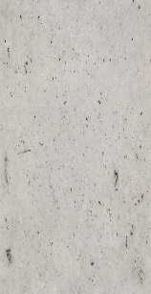
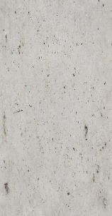
Window Well
Vertical Depth
> 44”
If the well vertical depth is greater than 44”, a ladder is required for egress

Slide 11


